Slide 1
Hypervisors
A hypervisor is software that creates and runs virtual machines (VMs).
It is computer software, firmware or hardware that creates and runs virtual machines.
A computer on which a hypervisor runs one or more virtual machines is called a host machine, and each virtual machine is called a guest machine
Type of Hypervisor
Type 1 - is a layer of software we install directly on top of a physical server and its underlying hardware.
Type 2 - This type of hypervisor runs inside of an operating system of a physical host machine.

Slide 2
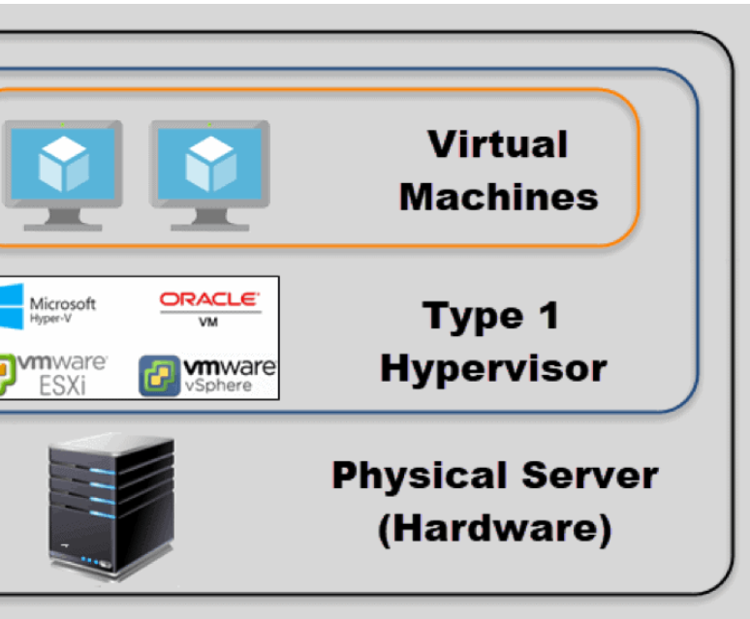
Type 1 Hypervisor

Slide 3
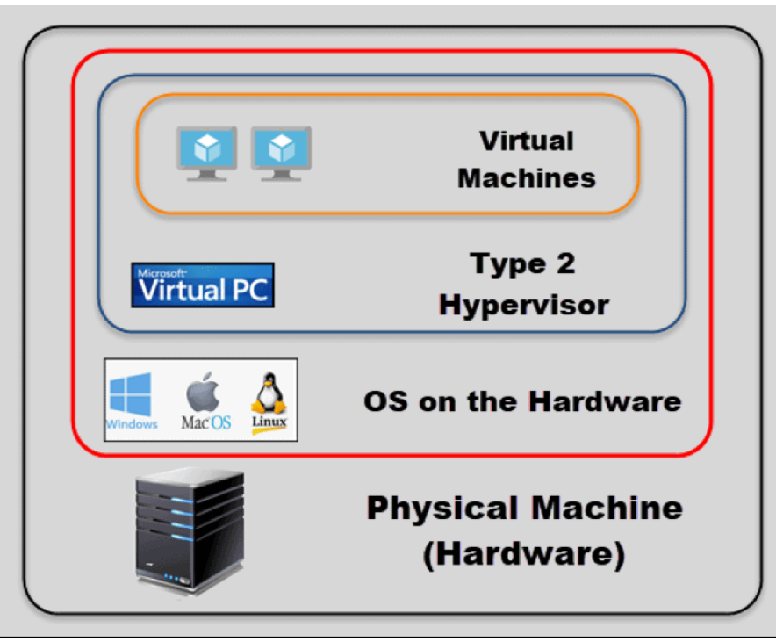
Type 2 Hypervisor

Slide 4
Resources required for a Linux VM in LAB
RAM 2GB is enough
Hard disk - 20 GB
Authentic Link to download ISOs for CentOS machines is as follows:
https://www.centos.org/download/
What Is an ISO File?
An ISO file, often called an ISO image, is a single file that's a perfect representation of an entire CD or DVD of any Operating System.

Slide 5
SHELL in Linux
SHELL is a program which provides the interface between the user and an operating system. When the user logs in OS starts a shell for user.
Command to check shell
echo $SHELL

Slide 6
Bash Prompt In Linux
We see the following default prompt in Linux environment: [username@machinename <current dir>]$
For example: [tom@localhost Desktop]$
Difference between $ and #
The dollar sign $ means the current user is a regular user.
A root user would be identified with a hash sign #.
For example: [root@localhost ~]#
# - requires given linux commands to be executed with root privileges either directly as a root user or by use of sudo command
$ - requires given linux commands to be executed as a regular non-privileged user

Slide 7
User add on the Linux Box
[root@localhost ~]# useradd <username>
[root@localhost ~]# passwd <username>
To verify if the user has been added or not – check the contents of the file which contains the user information i.e /etc/passwd
[root@localhost ~]# cat /etc/passwd
This will display the contents of /etc/passwd file and it should contain the information about the newly added user
Note: cat is used to see the contents of a file

